Slide 1



EXPLORING CARS WITH USER REQUIREMENTS

Slide 2
Team Members
S.Srinivas - AP21110010143
N.Madhav - AP21110011260
P.Guru Kiran -AP21110010707

Slide 3
CONTENTS
Abstract
Introduction
Objectives
Advantages
Libraries Used
Methods
Visualization
System Requirements
Conclusion

Slide 4

ABSTRACT
In the fast-paced world we live in today, owning a car has become more of a necessity than a luxury for many individuals.
With countless makes and models available, finding the perfect car that matches one's unique requirements can be a daunting task.
However, thanks to advancements in data analysis and machine learning, exploring cars based on user requirements has become more accessible and efficient than ever.

Slide 5
INTROUDUCTION
In this project, we will embark on a journey of car exploration using a comprehensive car dataset.
The dataset comprises various attributes and features of numerous car models, including specifications, performance metrics, pricing, and more.
Our goal is to leverage this data to create an intuitive and intelligent system that assists users in finding their ideal car based on their specific preferences and needs.

Slide 6
OBJECTIVES
The main objectives of this project " EXPLORING CARS WITH USER REQUIREMENTS " are :
Understanding User Requirements
Identifying Vehicle Options
Comparing Features and Specifications
Considering Budget and Affordability
Test Drives and Research
Safety and Reliability
Reviews and Recommendations

Slide 7
ADVANTAGES:
Exploring cars with user requirements offers several advantages that benefit both the user and the automotive industry.
User can easily find the specifications of required cars
User can save more time and cost by this project

Slide 8
LIBRARIES USED :
import numpy as np
import pandas as pd
import scipy.stats as stats
import seaborn as sns
The Python libraries NumPy, Pandas, SciPy.stats, and Seaborn are imported to facilitate data manipulation, statistical analysis, and data visualization.

Slide 9
METHODS:
isnull()
duplicated()
nunique()
fillna()
replace()
head()
tail()
describe()
info()
mean()
std()
groupby()

Slide 10
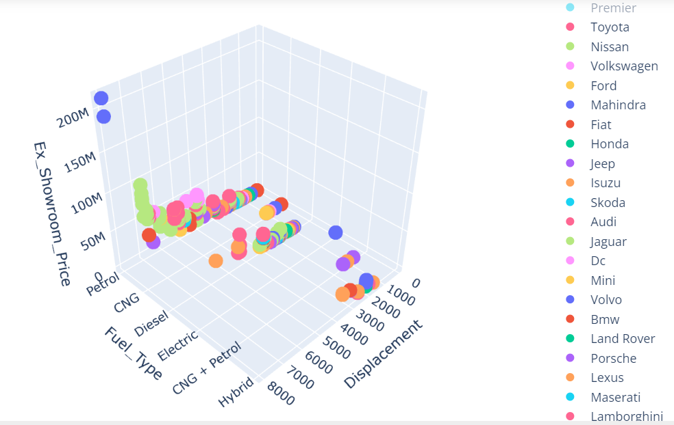
VISUALISATION:

Slide 11
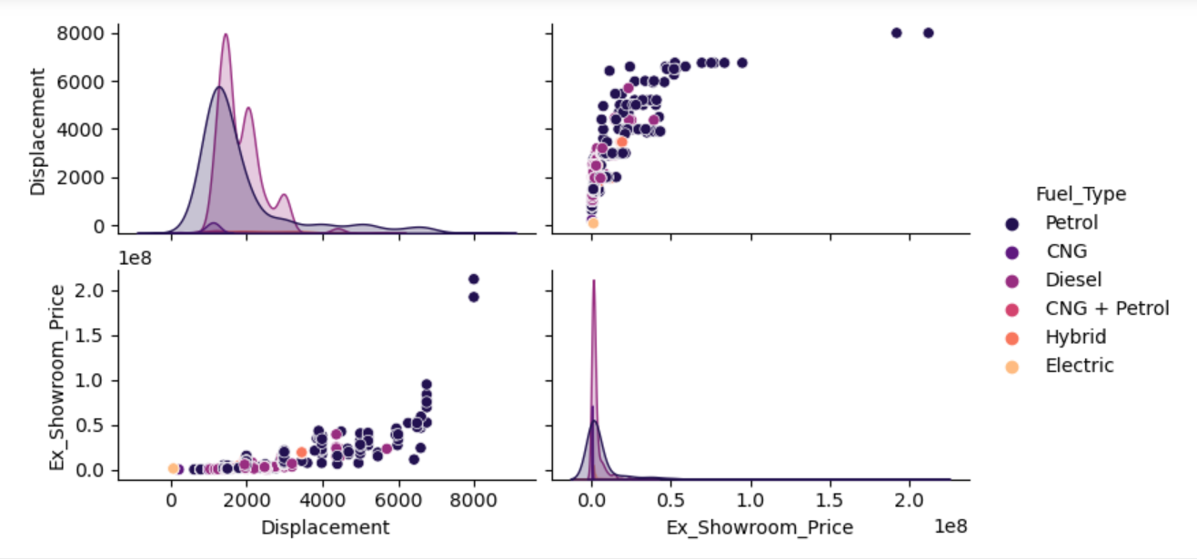
VISUALISATION:

Slide 12
SYSTEM REQUIREMENTS:
Software Requirements:
Jupyter Notebook
Excel/Notepad for CSV
App Data set
Different Libraries
Hardware Requirements:
Windows 7 or greater
4GB RAM
4GB ROM

Slide 13

CONCLUSION
By exploring cars with user requirements using a comprehensive car dataset, we aim to revolutionize the car selection process, making it a seamless and enjoyable experience for potential buyers. Through the amalgamation of data analysis and machine learning, users will gain valuable insights into the best-suited car models that align with their preferences, budget, and lifestyle. Ultimately, our project aspires to empower individuals to make informed decisions when it comes to choosing the perfect car for their needs.

Slide 14
STUDIO SHODWE
Thank You
SLIDE PRESENTATIONS DESIGN

